Slide 1
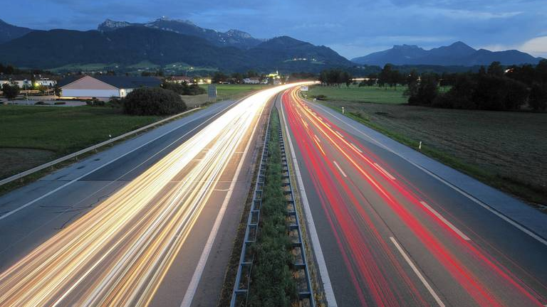

Autobahn
Traffic sign classification
Paul, Georg, 이장호, 이주현, 이지은
Notes:
Hello
We're the Autobahn team who will be presenting on the topic of road traffic sign classification.

Slide 2
Content
Project introduction
What is YOLO?
Reference Paper
Data labeling
Implementation
Result
Notes:
Project introduction : 30s~1m /지은
What is YOLO? : 1~2m / paul
Reference Paper : 2m /장호
Data labeling : 1m /georg -> upload labeling please
Implementation : 2~3m /주현
Result : 1~2m /지은
The table of contents is as follows.
First, we will introduce the project and the model we used, and we will show you the reference thesis and data labeling process.
Finally, we'll show you how we implemented it and what we've achieved.
목차는 다음과 같습니다.
먼저, 프로젝트에 대한 소개와 저희가 사용한 모델에 대해 소개해드릴 예정이고, 참고한 논문 및 데이터 라벨링 과정을 보여드릴 예정입니다.
마지막으로는 구현한 방법과 결과물에 대해 보여드리겠습니다.

Slide 3
Project introduction
Traffic Sign Classifier
: Traffic Sign detection and classification from real time data input
1. Traffic Sign Data acquisition
2. Select Deep Learning Model
3. Labeling Data
4. Train Model
5. Evaluate Model
Notes:
First, I will give you a brief introduction to the project. Our team carried out a project to detect and classify traffic signs in real time driving videos.
We acquired traffic sign data and labeled the data. For our deep learning model we used the YOLO algorithm. After training the model with our data we evaluated the performance of the model.
먼저 프로젝트에 대한 간단한 소개를 해드리겠습니다. 저희 팀은 도로주행 영상 속에 있는 교통 표지판을 탐지하여 분류하는 프로젝트를 진행하였습니다.
교통 표지판 데이터를 획득하고 딥러닝 모델을 정하고 데이터를 라벨링하였습니다. 그 후 모델을 학습시키고 평가하는 시간을 가져보았습니다.
//
주행영상 속의 도로 교통 표지판을 detect하고 classification하기
데이터 습득
모델 선정
라벨링
학습
평가

Slide 4
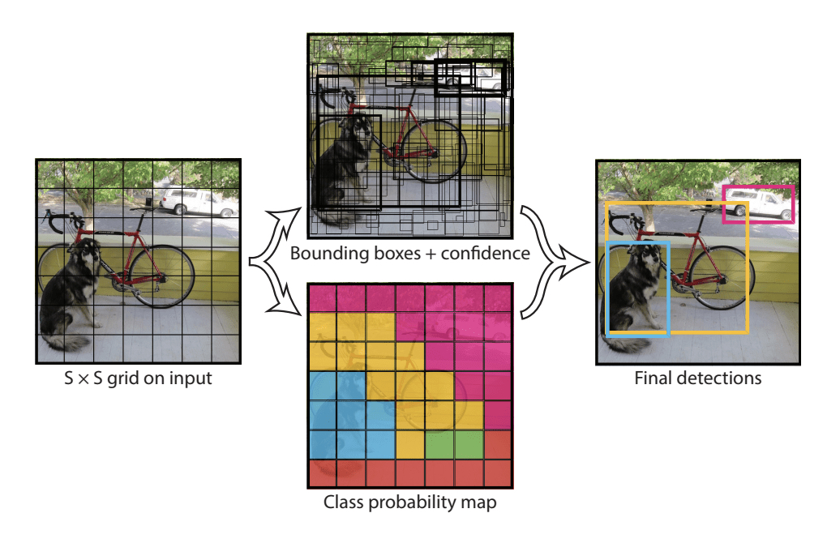
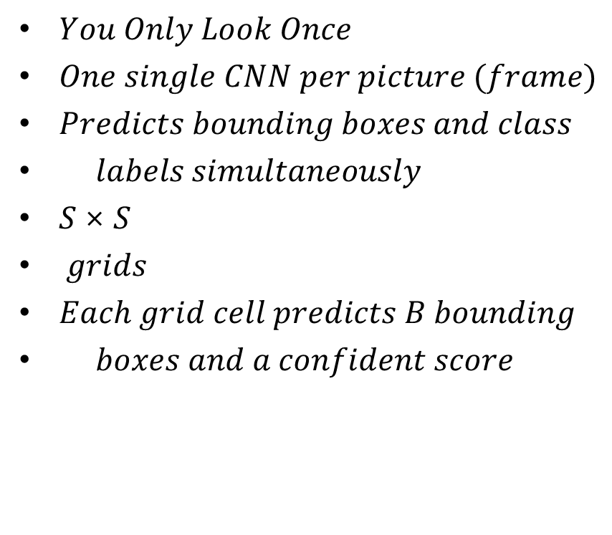
2. What is YOLO?
$You Only Look Once$
$One single CNN per picture (frame)$
$Predicts bounding boxes and class$
$labels simultaneously$
$S \text{×} S$
$grids$
$Each grid cell predicts B bounding$
$boxes and a confident score$
YOLO Architecture [1]

Slide 5
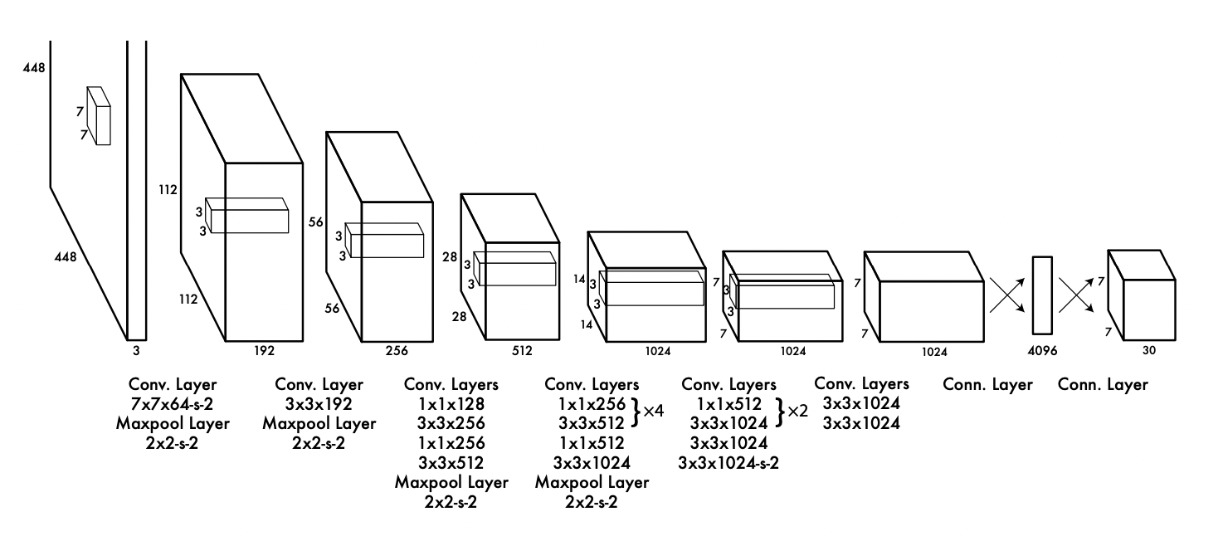
2. What is YOLO?
YOLO Architecture [1]

Slide 6
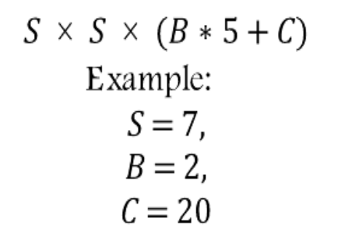
2. What is YOLO?
$$S \text{×} S \text{×} (B∗5+C)$$
$$Example:$$
$$S=7,$$
$$B=2,$$
$$C=20$$
YOLO Architecture [1]

Slide 7
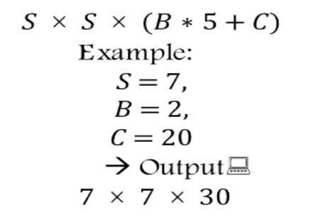
2. What is YOLO?
$S \text{×} S \text{×} (B∗5+C)$
$Example:$
$S=7,$
$B=2,$
$C=20$
$→ Output:$
$$7 \text{×} 7 \text{×} 30$$
YOLO Architecture [1]

Slide 8
2. What is YOLO?
$$S \text{×} S \text{×} (B∗5+C)$$
$$Example:$$
$$S=7,$$
$$B=2,$$
$$C=20$$
$$→ Output:$$
$$7 \text{×} 7 \text{×} 30$$
YOLO Architecture [1]
$${pred}_{cell}=\left[C_{1},C_{2},…,C_{20},p_{c1},x,y,w,h,p_{c2},x,y,w,h\right]$$
20 different classes
Box1
Box2

Slide 9
2. What is YOLO?
Compare YOLO with other models

Slide 10
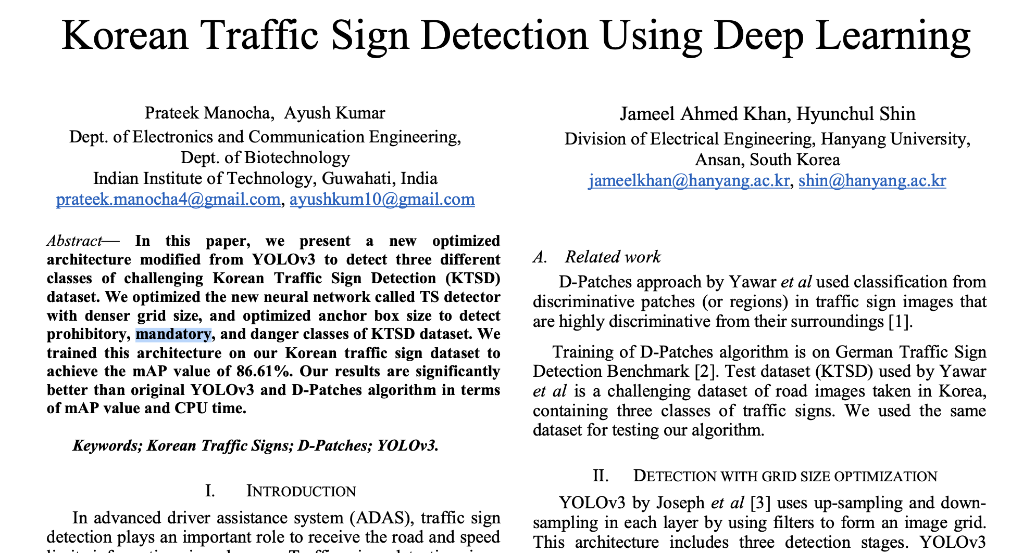
3. Reference Paper
https://ieeexplore.ieee.org/document/8649887
Notes:
https://ieeexplore.ieee.org/document/8649887
이 논문을 참조했음

Slide 11
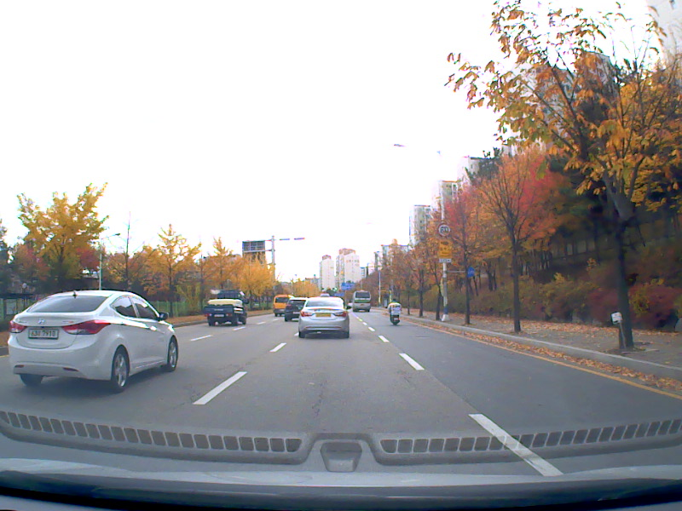
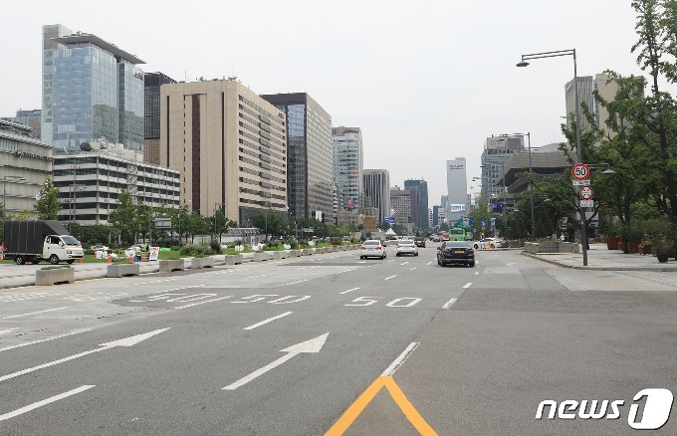
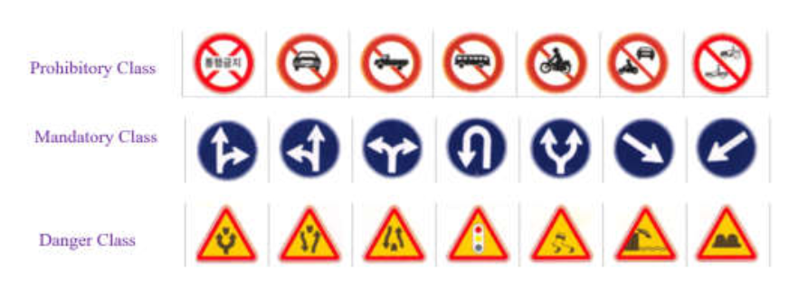
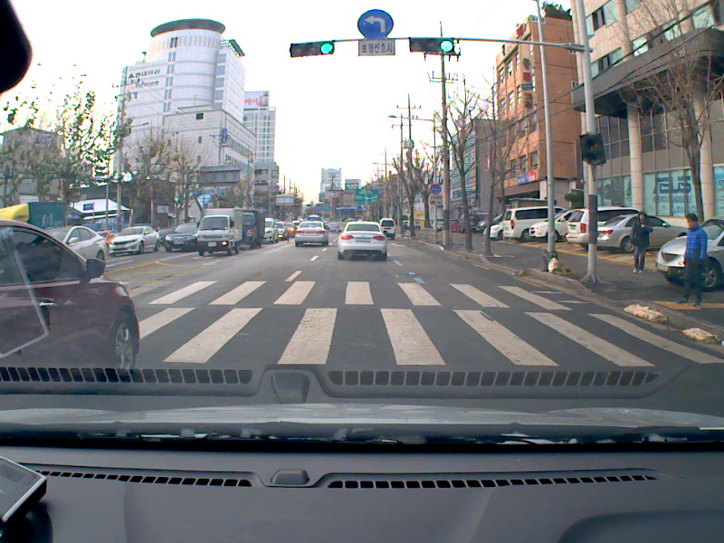
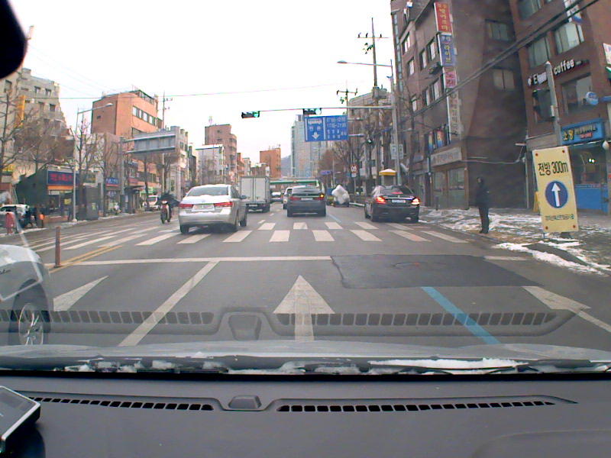
3. Reference Paper
Korean Traffic Sign Dataset
Korean Traffic Sign Classes
Training

Slide 12
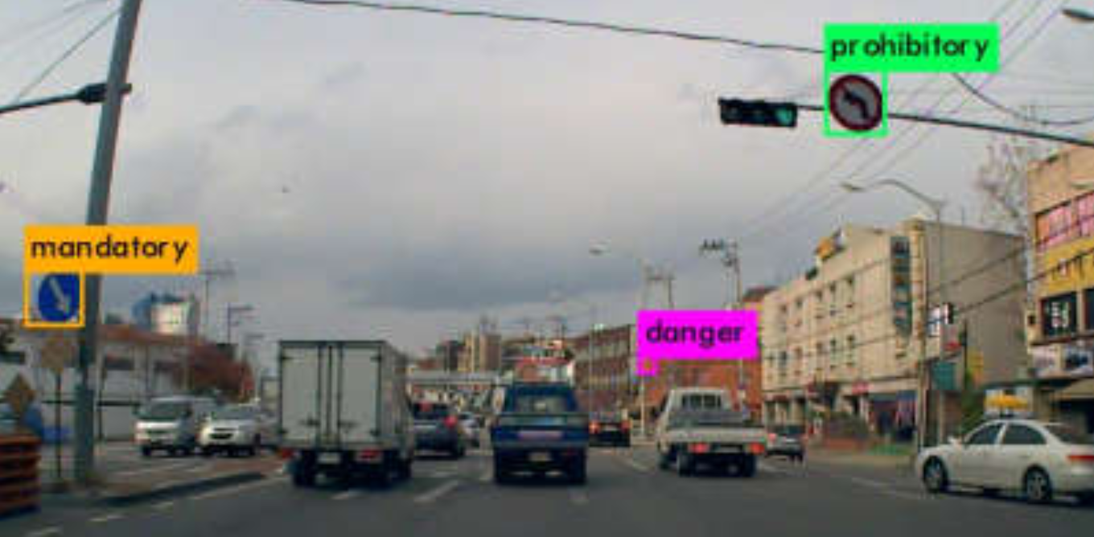
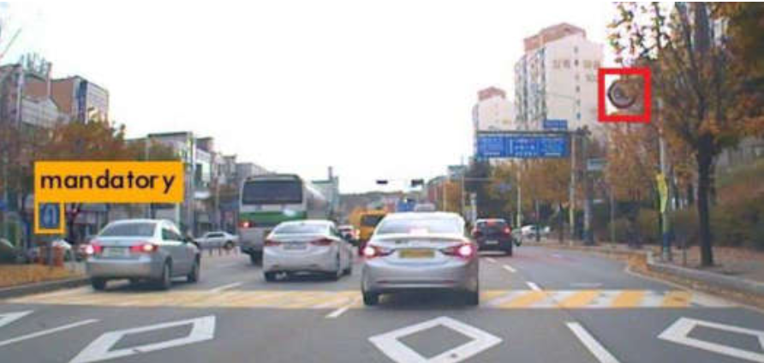
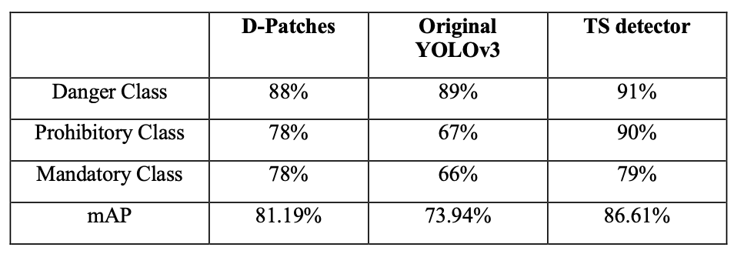
3. Reference Paper

Slide 13

3. Reference Paper
Korean Traffic Sign Dataset
Korean Traffic Sign Classes
Training with .

Slide 14







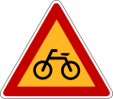

4. Data labeling
Software for labeling: LabelIMG
Supports YOLO
Coded in Python
Yolo is a supervised learning algorithm -> the data must be labeled
3 Different Classes of street Signs: prohibitory, mandatory and danger
prohibitory
mandatory
danger
Notes:
https://hc.hanyang.ac.kr/web/dslab/dataset?p_p_id=20&p_p_lifecycle=0&p_p_state=normal&p_p_mode=view&p_p_col_id=column-1&p_p_col_count=1&_20_struts_action=%2Fdocument_library%2Fview&_20_folderId=365651

Slide 15
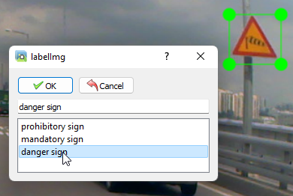
4. Data labeling
Data is being labeled by manually drawing boundary boxes around the street signs and assigning the class
Box coordinates and class is saved into a .txt file
Two datasets:
First Dataset was provided by Digital Systems Lab of Hanyang University: 500 pictures
Second Dataset taken from driving video on YouTube: 500 pictures
labeling

Slide 16
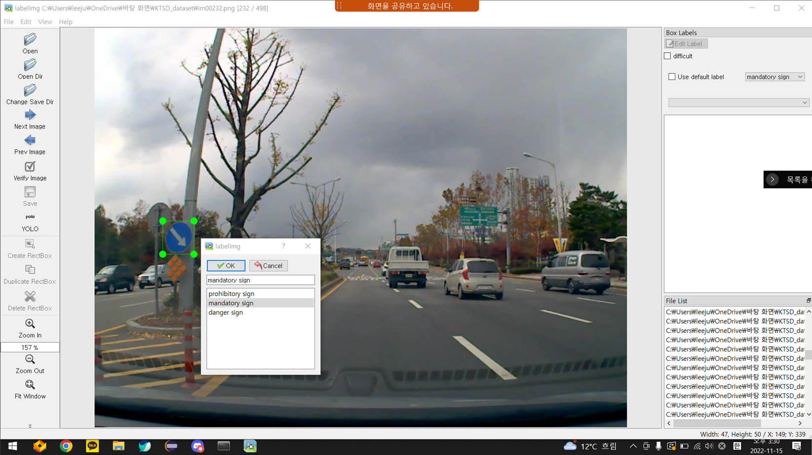
4. Data labeling

Slide 17
5. Implementation
Implemented on Colab
YOLO v4-darknet (tiny)
Original YOLO is very heavy => Too much time and resource
Code from https://github.com/AlexeyAB/darknet
https://colab.research.google.com/drive/1P1oZOUD8tj3pmvPFlPreW_XwQqjEUgu5?usp=sharing

Slide 18
6. Result
2 times of training
First with 500 data, and 1500 iteration
Second with 1000 data, 3000 iteration

Slide 19
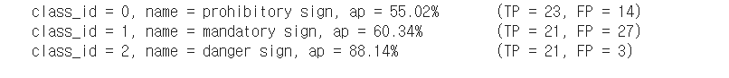
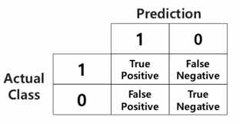
6. Result
1. 500 data with 1500 iteration
Notes:
Ap(Average Precision)
Tp(True Positive) – Predicted right, ground truth right
Fp(Fasle Positive) – Predicted right, ground truth wrong

Slide 20
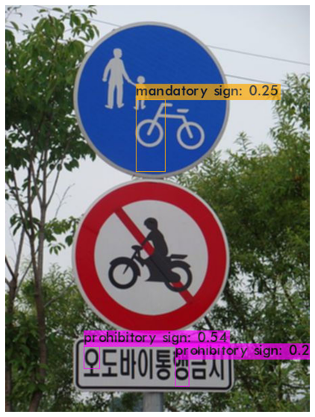
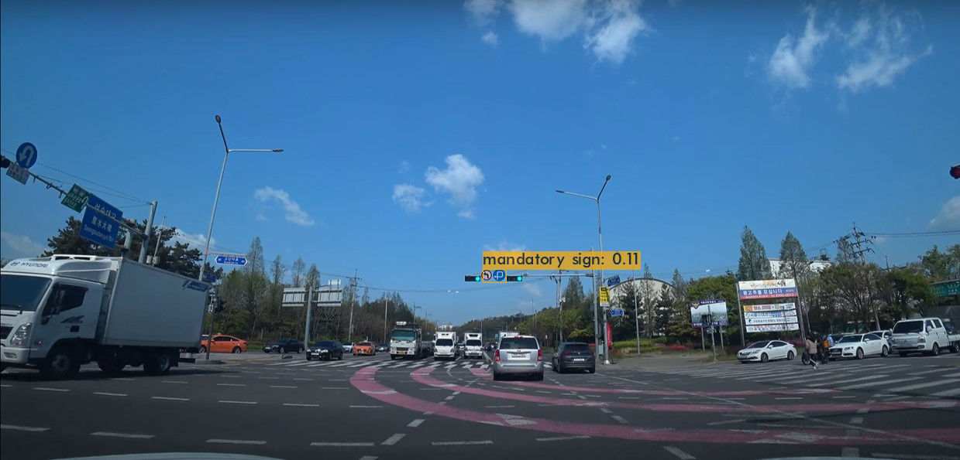
6. Result
1. First experiment tested on images
Because of low accuracy, tested with Threshold 0.1
Notes:
Threshold 0.1 means don’t show bounding box with accuracy lower than 0.1, which is 10%.

Slide 21
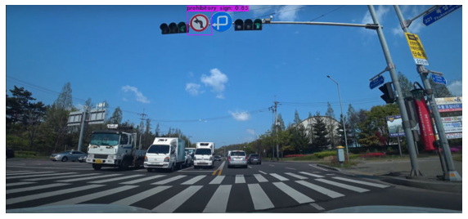
6. Result
Very bad accuracy => Try with more data and training!
Notes:
Threshold 0.1 means don’t show bounding box with accuracy lower than 0.1, which is 10%.

Slide 22
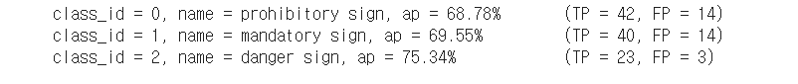
6. Result
2. 1000 data with 3000 iteration

Slide 23
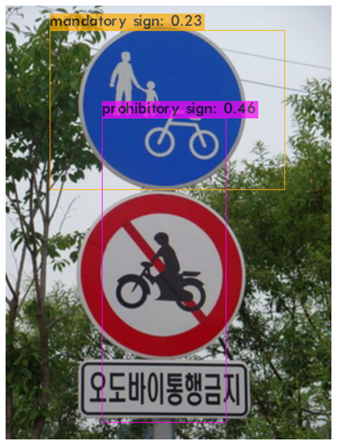
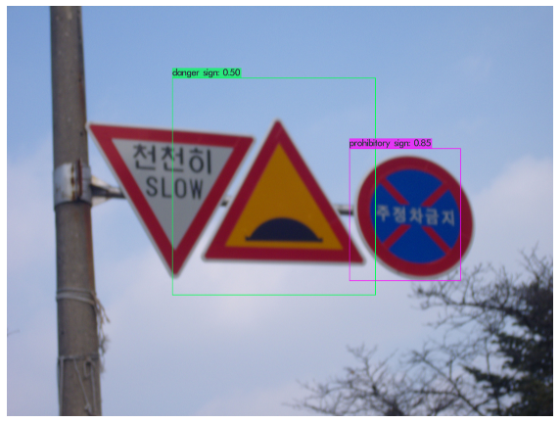
6. Result
2. Second experiment tested on images
Tested with Threshold 0.1 to check accuracy of each class
Notes:
Threshold 0.1 means don’t show bounding box with accuracy lower than 0.1, which is 10%.

Slide 24
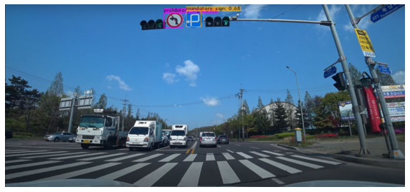
6. Result
Good accuracy on some test images
This image is perfect with threshold 0.5
Notes:
Threshold 0.1 means don’t show bounding box with accuracy lower than 0.1, which is 10%.

Slide 25
Conclusion
데이터가 클래스마다 골고루 있는 것이 필요
각 표지판마다 나눈 것이 아니라 표지판을 grouping했기 때문에 모양이 조금 바뀌면 인지하기 힘들 수 있음
데이터가 늘어나고 학습 이터레이션이 늘어나면 확실히 성능이 좋아짐. 시간이 있었으면 데이터를 더 추가했을 것.

Slide 26
Sources
https://ieeexplore.ieee.org/document/8649887
[1] J. Redmon, S. Divvala, R. Girshick, and A. Farhadi, “You only look once: Unified, real-time object
detecotion”, arXiv preprint arXiv:1506.02640, 2015.
[2] Alexey Bochkovskiy, Chien-Yao Wang, Hong-Yuan Mark Liao, “YOLOv4 : Optimal Speed and Accuracy of Object Detection”, arXiv:2004.10934, April 2020

